Slide 1

Importance of Risk Perception Factors for the Development of Effective Risk Communication after a Nuclear Accident
Ms. Yuliya Lyamzina, PhD, MBA

Slide 2
Content
The Importance of Risk Perception Factors
Incorporating Risk Perception into Risk Communication
Why address Perceived and Actual Risks?
Complexity of the Risk Perception Factors
Fukushima case
Way forward beyond education
Notes:
In my presentation I would like to cover some general communication issues, why is it important to address perceived risks, the whole complexity of risk perception factors and provide basic recommendations.

Slide 3
The Importance of Risk Perception Factors
Effective risk communication is a determinant in accompanying remediation and waste management projects.
Most risk communication efforts based on knowledge and trust building campaigns
Necessary but not sufficient to modify perceived risk
Fundamental to effective risk communication is the design of accurate risk messages based on actual risk assessment but also perceived risks responsive to the specific fears and concerns of involved stakeholders.
Notes:
This CRP is about defining a methodology assessing risk perceptions? Why?
Think of the HIERARCHY
1. Public acceptance is the ultimate goal (and the pre-requisite) for successful RWM and D&ER projects.
2. Public acceptance hinges on an effective stakeholder engagement program.
Stakeholder engagement is predicated on delivering effective risk communications (usually reassurance the projected dose is low, inconsequential)
Risk Communications need to be supported by carefully designed and crafted risk messages specific to a given group.
RESPONSIVE, EFFECTIVE Risk Messaging can be designed only with understanding the risk perceptions. (This is what never happens analytically or explicitly).

Slide 4
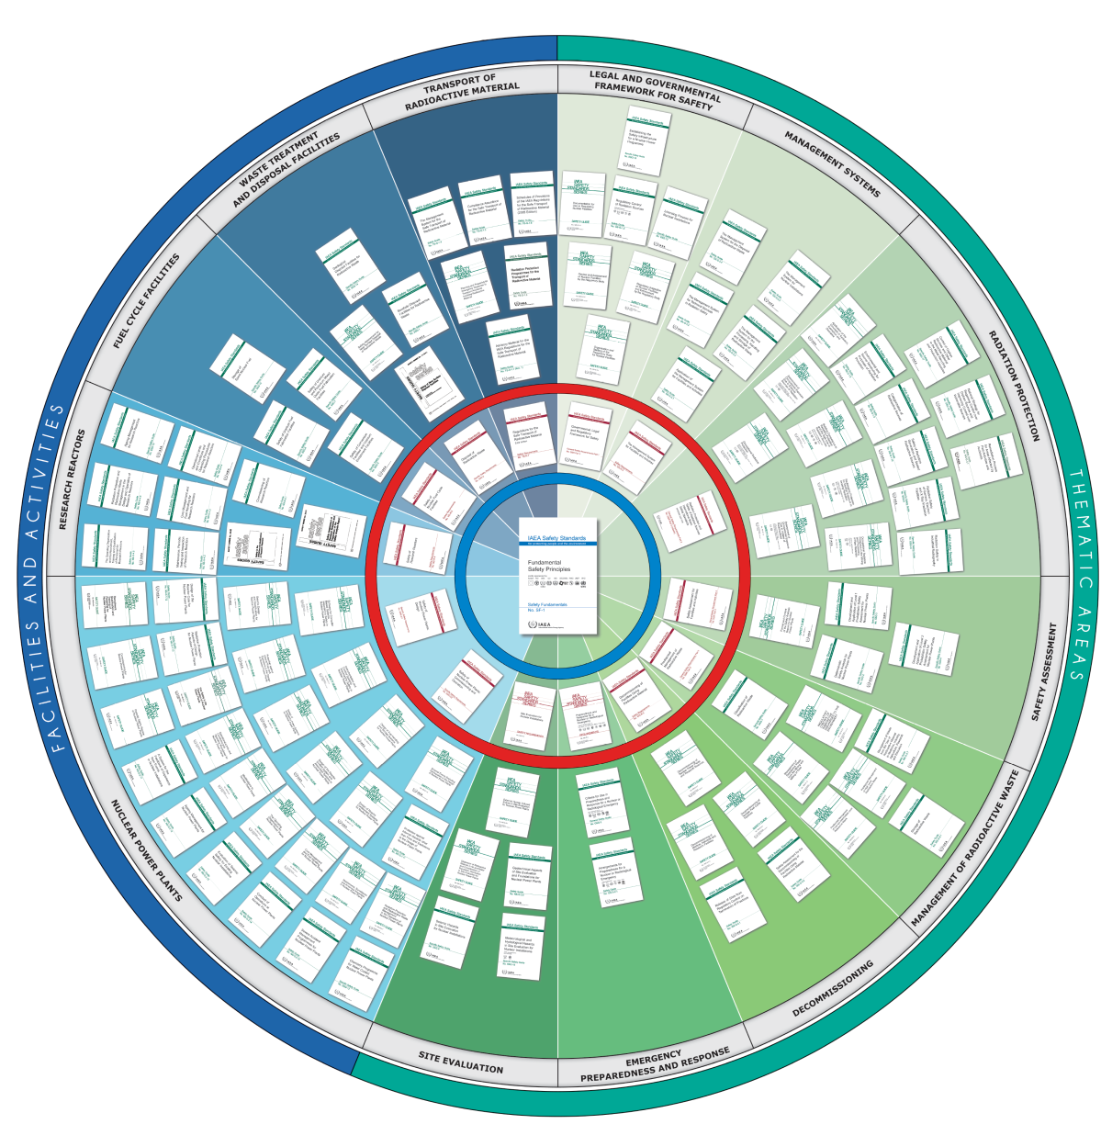
IAEA Safety Standards
They all contain the basic messages of “Basic principles of successful stakeholder involvement” :
Exhibit accountability;
Recognize the purpose of stakeholder involvement;
Understand stakeholder issues and concerns from the beginning;
Build trust;
Practice openness and transparency;
Recognize the evolving role of and methods for stakeholder involvement.

Slide 5
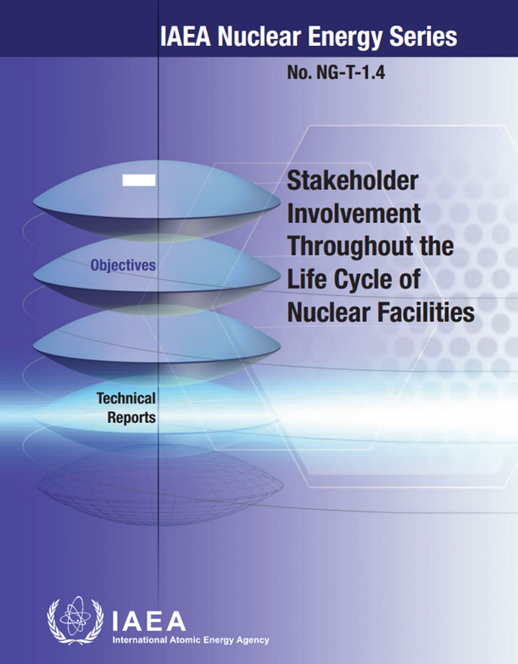
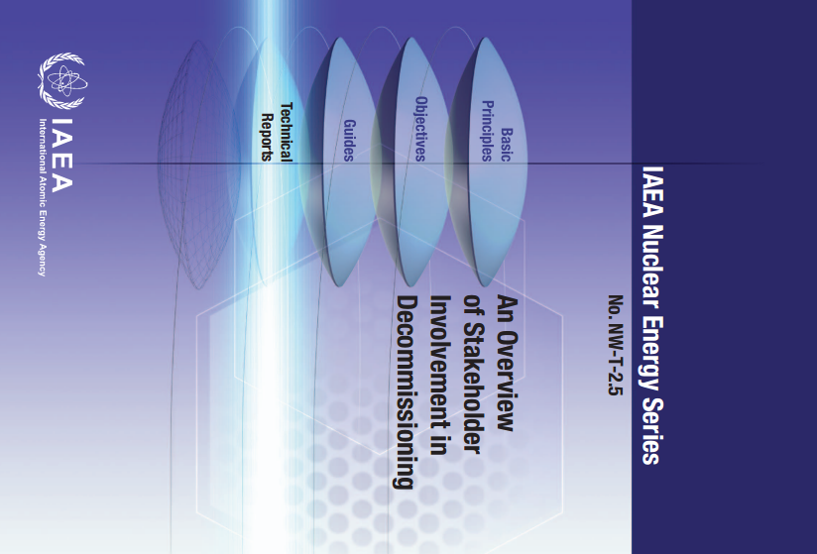

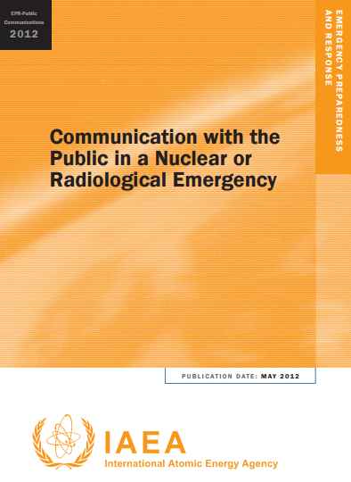
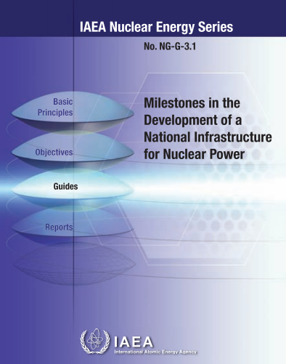
Other IAEA publications

Slide 6
Usual approach
New Approach
Stakeholder Engagement
Risk Communication
Actual Risk Assessment
Stakeholder Engagement
Risk Communication
Risk Messaging
Risk Perception Assessment
+
Actual Risk Assessment

Slide 7
Why Address Perceived Risk?
Communicating actual risk by sharing scientific results
is necessary
but not sufficient to respond to public concerns;
Understandable data (maps, reports, analyses) address intellectual needs for information;
Communications need to address emotions, fears, anxieties, perceptions and affects of stakeholders

Slide 8
Risks and Risk Communications
Actual risk (reality) is quantified, usually by dose calculations and probabilities of cancer/leukemia disease;
Perceived risk (fears, anxieties, beliefs, cultural differences, judgement and feelings) is subjective for the individuals and quantifiable in a population and single individuals;
The study of actual vs. perceived risk, especially regarding ‘nuclear issues’ is well established (e.g. Slovic, Fischhoff, et. al.),
Taking into account perceived risk for public communications in situations involving radiation risk is still in its infancy.
Notes:
Perceived risk- peoples belief, attitude, judjement and feelings, as well as the wider cultural and social dispositions they adopt towards threats to things that we value.

Slide 9
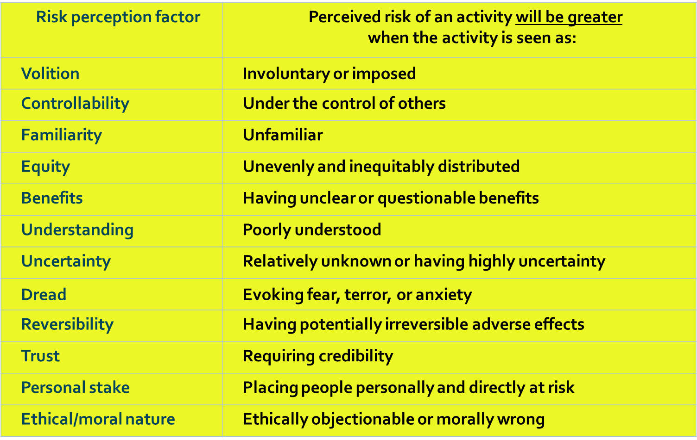
Complexity of the Risk Perception Factors

Slide 10
Additional issues to consider
Which of these perceptions exist among the community?
How strong are the perceptions?
Which demographic groups does exist?
What subgroup demographics exist?
How they correlate to each other?
How should messages be framed for the public, through which channels?
Should they be captured in the Regulatory documents?

Slide 11
Multiple Consequences of an Accident:
Fear of cancer and other medical complications;
Rumours and anecdotal reports;
Intelligible communications about radiation;
Contradictory information from “reliable sources”;
Distrust in authorities;
Ecological and socioeconomic disruption (unemployment, etc.);
Social stigma;
Media coverage (not always fair and balanced);
Psychological consequences:
Health related anxiety,
Excess morbidity from depression,
Post-traumatic stress disorder (PTSD),
Alcoholism and abuse of other substances,
Long-term threat to health, including next generations
After accidents involving radiation, questions, concerns and fears start early and the emotional toll goes on for years.

Slide 12
Fukushima case

Slide 13
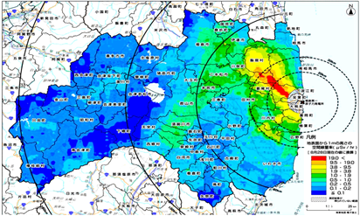
Background
11 Mach 2011 – “triple disaster” in Japan:
Earthquake
Tsunami
Nuclear accident

Slide 14
“The Fukushima nuclear accident abruptly deprived our peaceful everyday lives.”
“Fukushima is receiving lesser attention. But the disaster is not over, and the torment remains.”
(Interviews with affected residents)

Slide 15
Fukushima Prefecture Background
Massive amounts of prefecture monitoring data is available:
Multiple sources, multiple types of data
These data are used to try to convince people that there is no need to worry about residual levels of radiation with respect to health
Based on actual risk assessment, experts are formal: “doses are within safe levels”
Is this approach effectively improving public acceptance?
Is it aiding Fukushima people to better understand what is at stake?

Slide 16
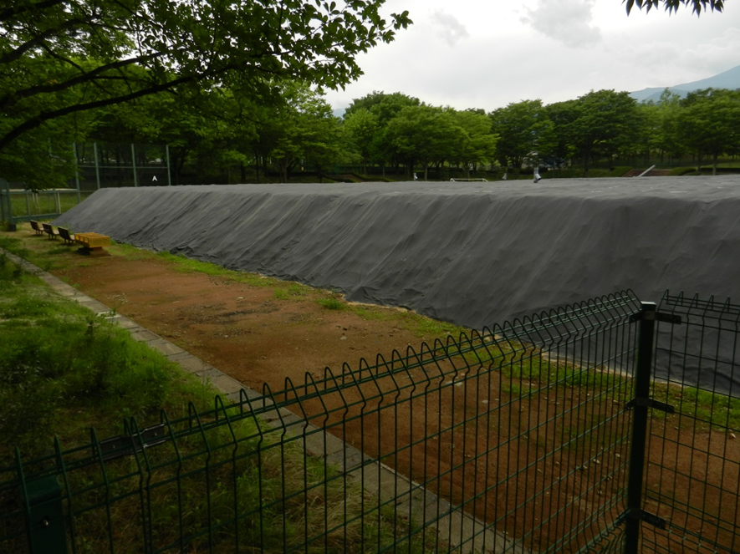
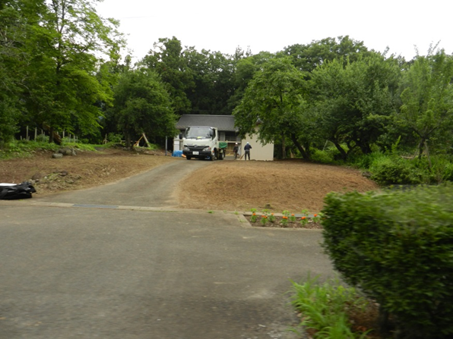
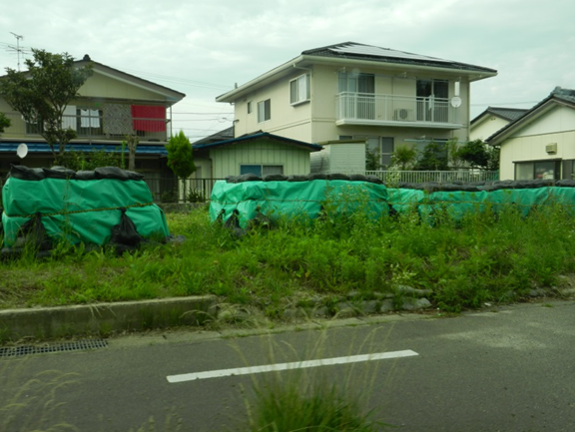
Which of the risk perception factors might be relevant to the sub-populations of the Fukushima Prefecture?

Slide 17
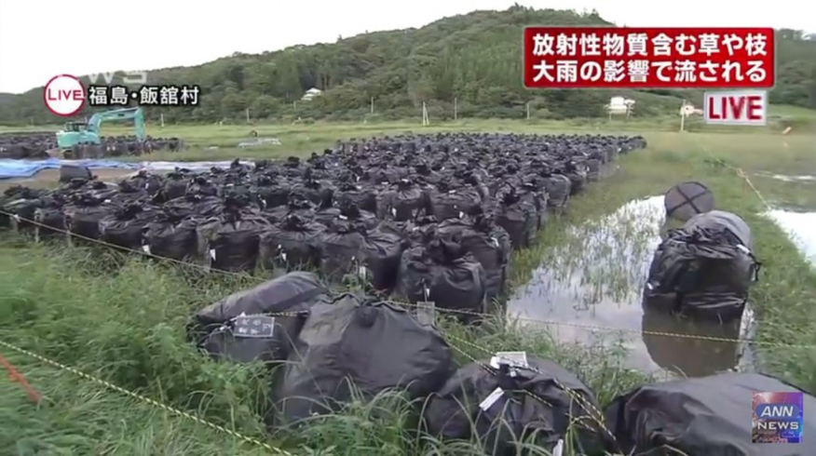
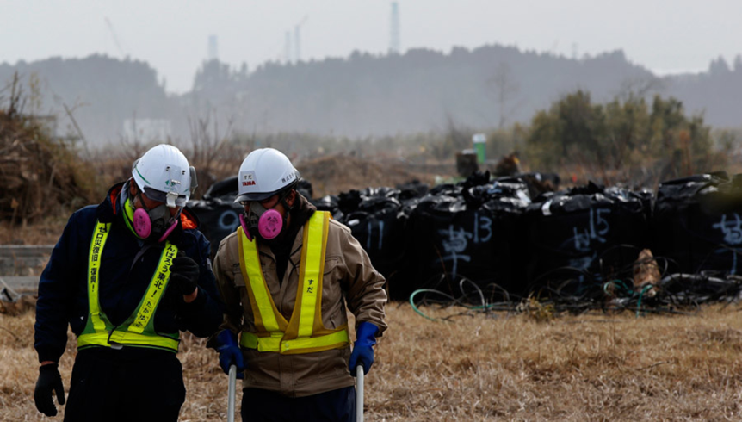
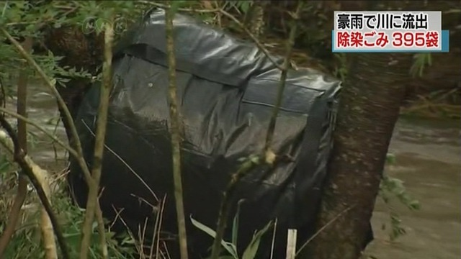
Understanding and uncertainty
Perceived risks of an activity is greater when the activity is seen as poorly understood, unknown and uncertain

Slide 18
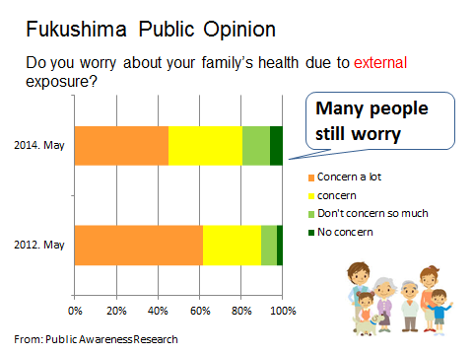
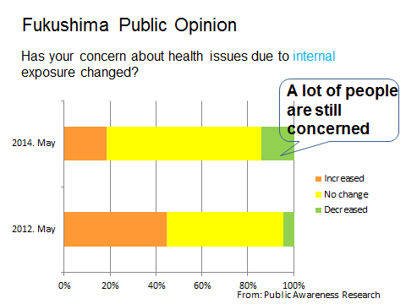
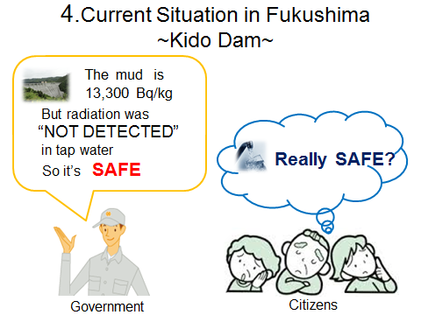
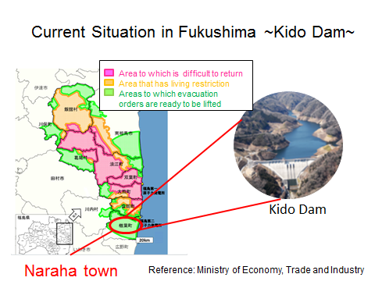
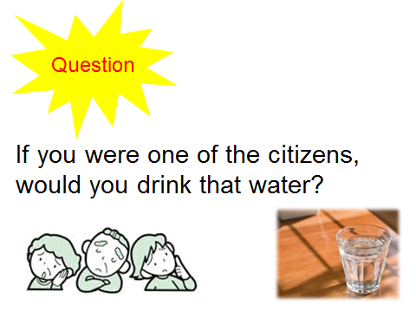
Perceived Risk after Fukushima Accident

Slide 19
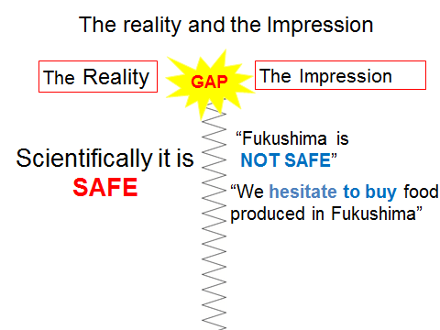
Fukushima Prefecture Actual and Perceived Risk
Risk perceptions are still prevalent and recognized in Fukushima Prefecture
Currently we are only addressing actual risk
We do not yet, but should also address perceived risk
The perception
The perception

Slide 20
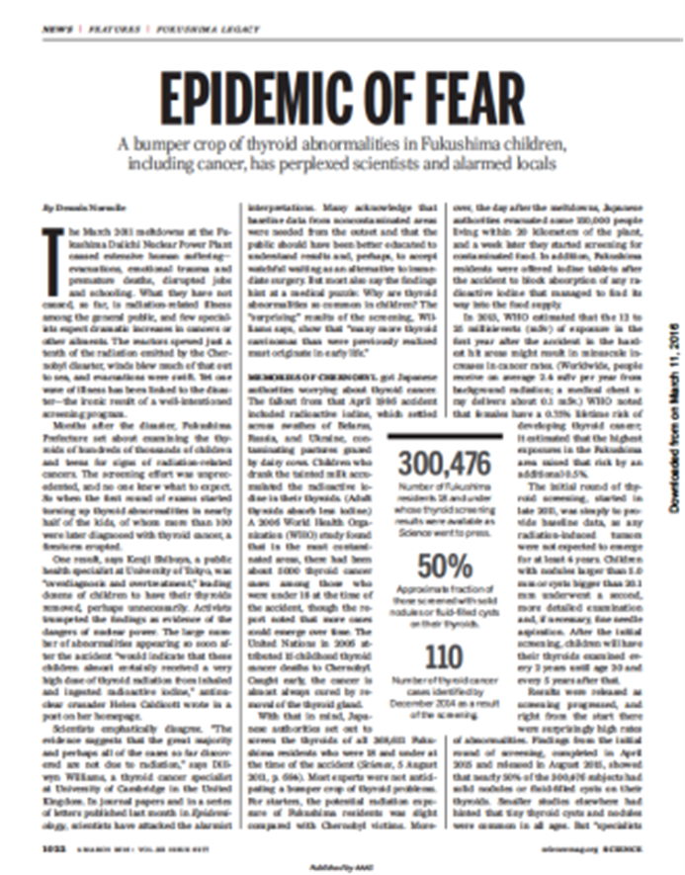
Psychological Distress (Fukushima Medical University survey)
Notes:
Post-traumatic stress responses
Chronic anxiety and guilt
Ambiguous losses
Separated families and communities
Stigma and self-stigma

Slide 21
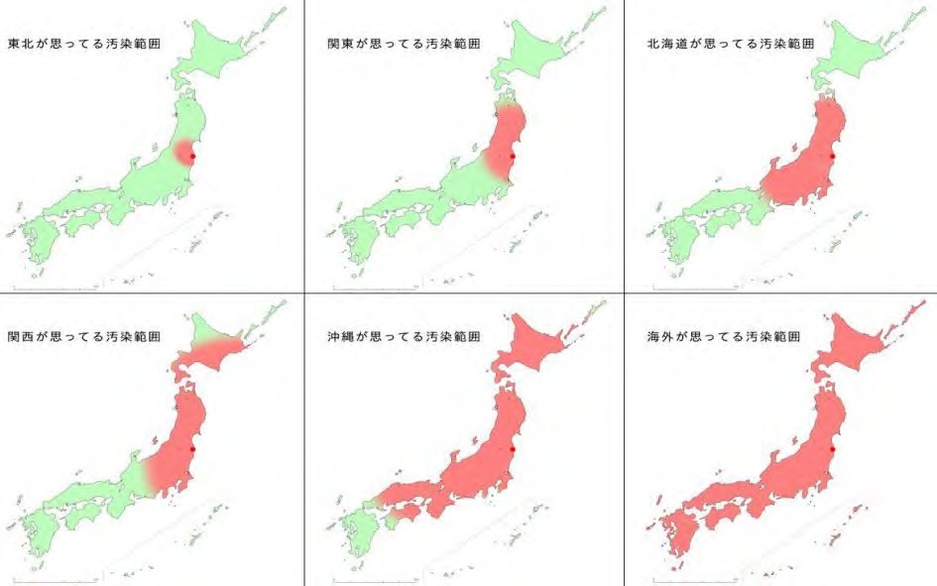
Misconception (perceptions) of Contamination Extent
People in Fukushima
Prefecture believe
People near Tokyo believe
People in Hokkaido believe
People in Osaka & Kyoto believe
People in Okinawa believe
The World believe
Source: http://www.yukawanet.com/archives/3930193.html
Notes:
ざっぱくな話ばかりでまとめようがないが、敢えて、最後に言うとすればと思って書き出しました。
還元して下さい。
ニュートンやプラトンは偉大な科学的功績を残したが、彼らは貴族だった。必要な資金は皆ポケットマネー。機構は税金で研究・技術開発を行う。成果を社会に還元するのは義務。
アウトカムとして、実社会へ直接役に立つことは還元のひとつ。一方、そうでなくてもあなたたちが考えて考えて考え抜いて得た貴重な結果を、同世代や次の世代に伝えて欲しい。それも還元。安全研究センターは両方持っていると思う。
どちらにせよ、宣伝して欲しい。宣伝に時間や労力を惜しまない。損にはならない。
ただ、得手不得手がある。出来る範囲で努力するしかない。私は、この世で何が嫌いかと言って、人前でしゃべることほど嫌なものはない。そういう役回りになっているので、そして伝えたいことはあるので、無理してしゃべっている。
研究と言う行為は、よく自由な発想で何て言われるが、つまりは何もかも自分で考えなくてはいけないのだから、しんどい行為と思う。しかし、自分が満足した結果を考えようによってはいろいろと社会に還元できるんだから、研究という行為はエネルギーを注ぎ込むだけの価値はある。

Slide 22
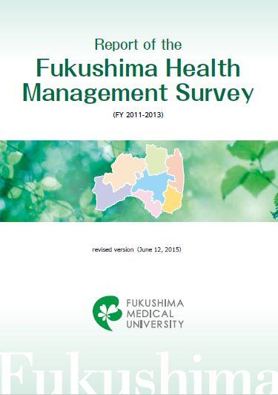
Mental Health and Lifestyle Survey
http://fmu-global.jp/?wpdmdl=1032

Slide 23
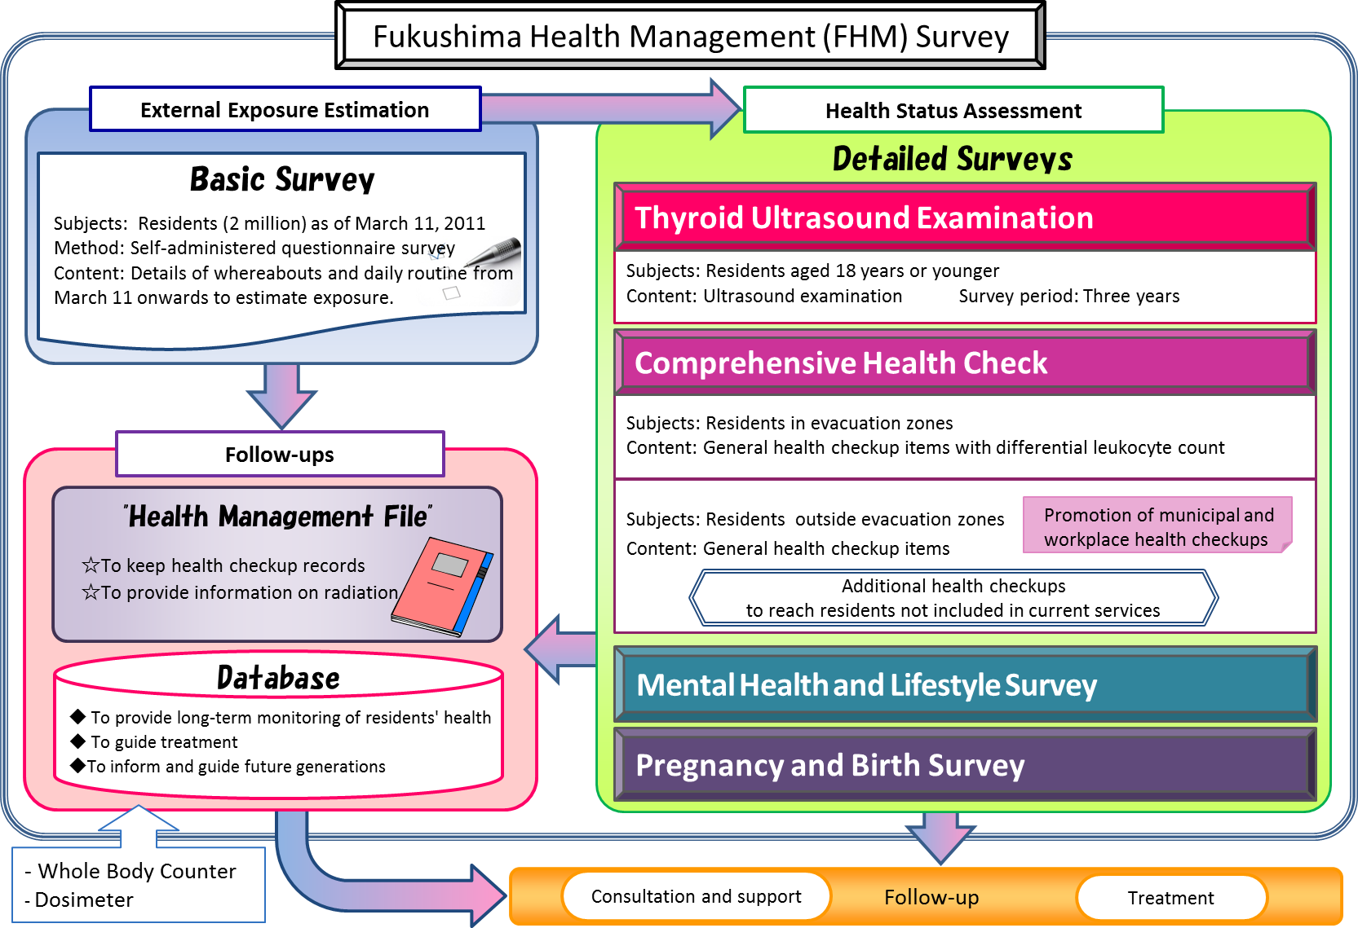
Mid-term health consequences

Slide 24
Current challenges of Fukushima
Technical Challenges of Decommissioning of the Nuclear Reactors
Site selection for the final disposal facility
Reducing the volume of the waste by re-using some of it for construction works
Remaining evacuees
Perceptions of radiation risks
Health problems
Thyroid
Mental health problems:
Bulling at schools Youth Suicide
Stress and PTSD all aspects of life (substance abuse,
obesity, cancer, divorces, suicide among adults, etc.)
Mental health of mothers
Process will take another 30-40 years to complete

Slide 25

Conclusion
The Fukushima accident, just as Chernobyl, reveled the importance of social and psychological consequences after a nuclear accident .
The emerging adverse effects on mental health due to the accident and health problems caused by long-term dislocation, are much more significant than the direct effects of radiation.
It is essential to apply holistic approach in order to develop specific measures for mitigating the overall health risks in order not to cause more harm than good in case of the next accident

Slide 26

Conclusion (cont.)
Science of risk perception psychometrics on par with the science of physical, actual risk assessment is a unique opportunity to support local population affected by existing exposure situations and provide them with sense of ownership .
The more a person dreads an activity, the higher its perceived risk and the more that person wants the risk reduced
Notes:
Psychometric research identified a broad domain of characteristics that may be condensed into three high order factors: 1) the degree to which a risk is understood, 2) the degree to which it evokes a feeling of dread, and 3) the number of people exposed to the risk. A dread risk elicits visceral feelings of terror, uncontrollable, catastrophe, inequality, and uncontrolled. An unknown risk is new and unknown to science. The more a person dreads an activity, the higher its perceived risk and the more that person wants the risk reduced.

Slide 27
Take away message
Accurate scientific information and education is important, but not sufficient to address the questions and concerns of the affected population
Need to understand how different people and different demographic groups perceive risk in order to:
tailor risk communication
improve public communication
provide them with sense of ownership
help them to regain control on their daily life and also restore trust in authorities and experts

Slide 28
“The risk management is a two-way street:
just as the public should take experts’ assessments of risk into account, so should experts respect the various factors, from cultural to emotional, that result in the public’s perception of risk “
(Paul Slovic).

Slide 29
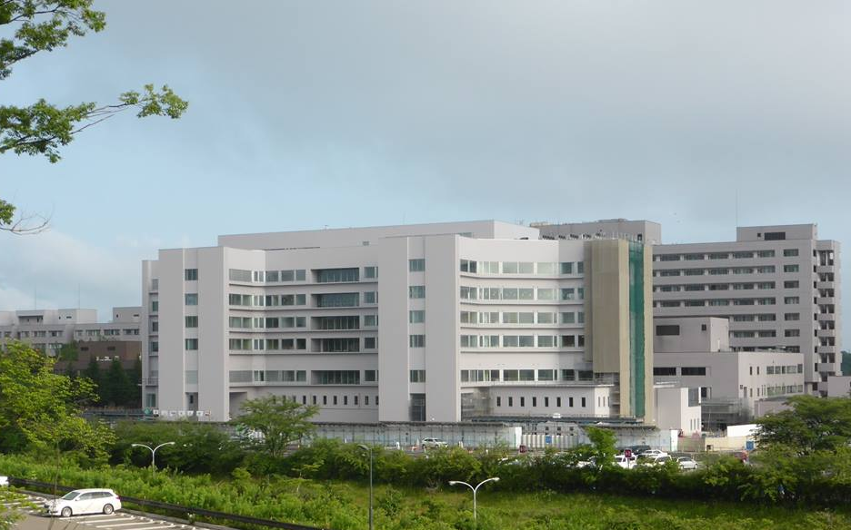


Thank you for attention!
lyamzina@fmu.ac.jp

